Slide 1
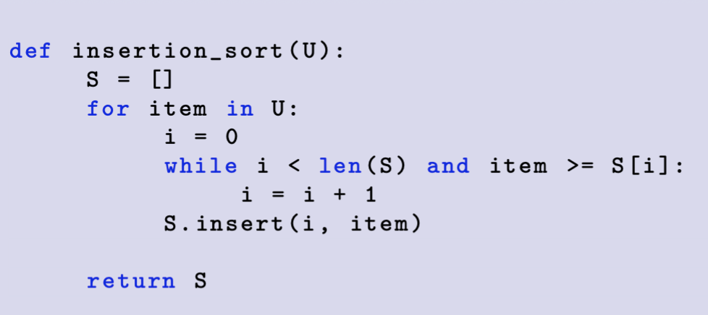
Ex1 Insertion Sort
0
1
2
3
4
5
6
U:
10
0
-10
-29
10
-31
-25
Iteration #
S[0] | S[1] | S[2] | S[3] | S[4] | S[5] | S[6]
S:
10
0
10
0
10
-10
0
10
-29
-10
0
10
-29
-10
0
10
10
-31
-29
-10
0
10
10
-31
-29
-25
-10
0
10
10

Slide 2
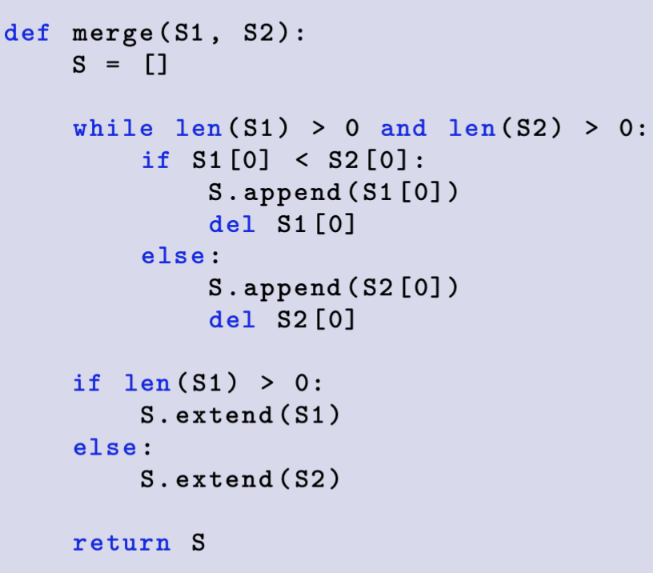
Demo1Merge
S1, S2 are sorted sequences
0
1
2
0
1
2
S1:
S2:
Iteration #
S[0] | S[1] | S[2] | S[3] | S[4] | S[5] | S[6]
S:
-99
-99
-93
-99
-93
-49
-99
-93
-49
10
-99
-93
-49
10
23
-99
-93
-49
10
23
74

Slide 3
Ex2 Merge sort recursion tree divide step
0
1
2
3
4
5
6
7
U:
-24
21
-45
-71
14
-41
50
-24
21
-45
-71
14
-41
50
-24
21
-45
-71
14
-41
50
21
-45
-71
14
-41
50

Slide 4
Ex2 Merge sort recursion tree conquer step
S:
-71
-45
-41
-24
14
21
50
-45
-24
21
-71
-41
14
50
-24
-45
21
-71
14
-41
50
21
-45
-71
14
-41
50

Slide 5
Ex4 Quick sort recursion tree divide step
Use last item as pivot
0
1
2
3
4
5
6
7
U:
94
21
35
35
-95
98
8
11
-95
8
11
94
21
35
35
98
-95
8
94
21
35
35
98
21
35
35
94

Slide 6
Ex4 Quick sort recursion tree conquer step
pivot
S:
-95
8
11
21
35
35
94
98
-95
8
11
21
35
35
94
98
-95
8
21
35
35
94
98
21
35
35
94

